Slide 1


JIGSAW PSHE 3-11
UPDATED FOR THE 2025 GUIDANCE
What do you need to know?
February 2026
Notes:
For Primary Schools - internal use only.
This presentation may be used in school for you to explain the changes in guidance and the changes in Jigsaw PSHE to your colleagues in school as part of your whole school consultation and preparation for moving to the new 2026 content.
©2026 Jigsaw Education Group

Slide 2
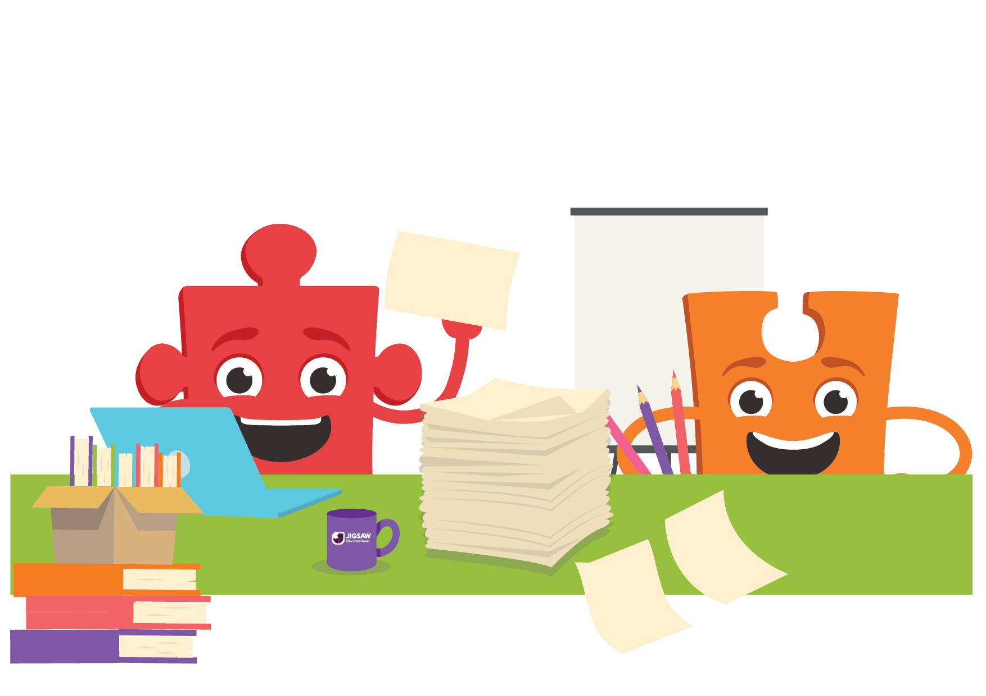
TODAY’S FOCUS
1. What's changed
A practical walkthrough of the key updates to Jigsaw content
Navigating the updated materials and supporting documents
2. Where to find it
3. How to implement
Practical steps for rollout, communication and policy review
© Jigsaw Education Group

Slide 3



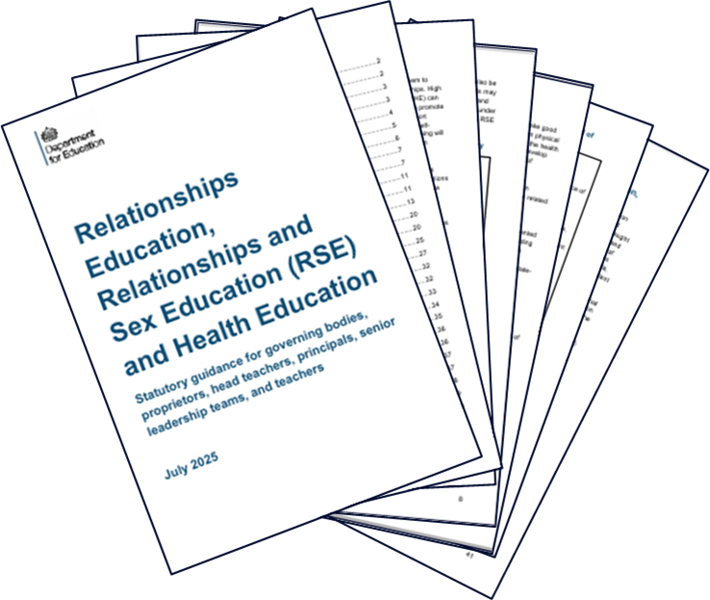




NEW DfE RSHE GUIDANCE (2025)
New 2025 statutory guidance
(England only)
Implementation for September 2026
Schools can start to implement guidance as soon as they are ready.
Jigsaw schools are already meeting some new content.
To replace 2019 guidance
Follows 2024 consultation
Links to other legal obligations and statutory requirements
Takes into account feedback and current research and good practice.
Retains flexibility for professional judgement.
© Jigsaw Education Group

Slide 4
KEY PRINCIPLES FOR EFFECTIVE RSHE
as identified in 2025 Guidance
Careful sequencing
Relevant and responsive
Positivity
Skilled delivery of participative education
Engagement with pupils
Engagement and transparency with parents
Whole school approach
Notes:
These seven key principles are already embedded in our Jigsaw PSHE curriculum. This takes a positive, empowering approach - building children's confidence and practical strategies rather than relying on fear-based messaging.
Pupil engagement is central to every lesson through participatory activities, circle time, and reflection.
The whole-school approach comes through in our consistent language, characters, and ethos from Early Years through to Year 6 with parent engagement is supported through ready-made resources that help us communicate openly about what's being taught.
When it comes to being relevant and responsive, this works at two levels. Jigsaw continually update the materials to reflect national trends, new research, and statutory guidance changes - so we can be confident we're current and compliant. This provides a robust foundation from which we can then make adjustments to reflect our local context, the needs of our children, and any questions that arise in the classroom. It's flexibility within a carefully planned structure - not starting from scratch, but tuning what's already there.

Slide 5
Wide range of family structures, including same sex parents
STATUTORY RELATIONSHIPS CONTENT
Families and people who care for me
Wide range of family structures, including same sex parents
Caring Friendships
Loneliness is normal and there is no shame in feeling or discussing it
Respectful Relationships
Greater focus on self esteem, setting and respecting boundaries, building resilience and how to find support.
Online Relationships
Enhanced online safety requirements (critical evaluation of materials, social media age limits, awareness of upsetting content)
Further details on developing skills to stay safe in relationships and teaching on when and how to seek support
Being Safe
Recommended from Yr5 onwards and schools to offer further support to parents
Sex Education (non-statutory)
© Jigsaw Education Group

Slide 6
STATUTORY HEALTH AND
WELLBEING CONTENT
General Wellbeing
Minimal changes to Healthy Eating, Drug Education, Physical Health and First Aid
Wellbeing Online
Physical Health and Fitness
Active promotion of physical & mental health, recognising what is appropriate and proportionate, when to seek help
Healthy Eating
More on online behaviours incl: safety and rights relationships, gaming (including addiction), potential financial harms, social media, apps, sharing images, impact on physical health and offline relationships.
Drugs Alcohol, Tobacco and Vaping
Health Protection and Prevention
Personal Safety
Clarity on teaching specific vocabulary for external body parts, and when menstruation is advised to be taught
Basic First Aid
Personal Safety: New topics on safety in and out of the home, including fire, water, road and rail.
Developing Bodies
© Jigsaw Education Group
Notes:
“Health education in primary starts with the benefits and importance of physical activity, good nutrition and sufficient sleep, and supports pupils to develop emotional awareness.
Schools should emphasise the relationships between physical health and mental wellbeing, and the benefits of physical activity and time spent outdoors.
As in all of RSHE, care should be taken to avoid exposing pupils to concepts which are not appropriate for them. Schools should continue to build on the primary health and wellbeing curriculum content in secondary “
Paragraph 40

Slide 7

WHAT YOU’RE ALREADY DOING
Jigsaw schools are already teaching content aligned with most of the new statutory expectations
Same six Puzzles, same sequence
Evidence-informed, whole-school approach
Emotional literacy and safeguarding embedded throughout
Updates enhance and strengthen – they don't replace
© Jigsaw Education Group

Slide 8




CHANGES WOVEN INTO PROGRAMME
BEING ME IN MY WORLD
CELEBRATING DIFFERENCE
Minor updates, enhanced protected characteristics content
Refreshed content, no structural changes
DREAMS & GOALS
HEALTHY ME
Some restructuring, 2 new lessons
Substantial changes: 3 new safety lessons, Safety STAR framework
RELATIONSHIPS
CHANGING ME
Updated digital literacy content, lesson names updated
Significant changes: 4 new lessons, restructured puberty/sex ed content.
© Jigsaw Education Group
Notes:
Here’s an overview. You can see straight away that the changes aren't evenly spread across the programme.
Some Puzzles do have totally new lessons – but the majority of the changes are woven throughout

Slide 9


SEX EDUCATION
FOR PRIMARY
NEW
‘This process should include offering parents support in talking to their children about sex education and how to link this with what is being taught in school as well as advice about parents’ right to request withdrawal from sex education.’
“Sex Education is not compulsory in primaries, and parents have the right to withdraw their children from sex education as part of RSHE, but we recommend that primaries teach sex education in years 5 and/or 6.”
© Jigsaw Education Group
Notes:
Currently Sex Education content starts in Yr4, with alternative option
Now starts with one lesson in Yr5 and then one in Yr6.
Alternative content to use in Jigsaw+ for schools choosing not to.
New leaflets coming to support parents

Slide 10



WHAT CHANGES WILL YOU SEE?
Reviewing content threaded through whole programme
New Lesson Content
Sources of Support
General Wellbeing
Teacher and Parent Materials
Updated teaching and learning activities strengthen existing content and include new topics.
Some new lessons
Strengthened focus on how and when to seek help across a wider range of topics
New training and support for schools.
Social and emotional learning more explicit for pupils and more clearly linked to physical health.
Mapping clearer for teachers.
Updates to mapping and supporting materials.
New materials to support parents.
© Jigsaw Education Group

Slide 11
PUZZLES WITH FEWER CHANGES
BEING ME IN MY WORLD
CELEBRATING DIFFERENCE
RELATIONSHIPS
No structural changes
Content refreshed
Enhanced citizenship and democracy content
2 lessons renamed (Ages 6-7)
Enhanced courtesy and manners focus
Strengthened protected characteristics content
Lesson names updated (Ages 7-8)
Significant digital literacy updates woven through
Enhanced SMARRT rules
© Jigsaw Education Group

Slide 12


DREAMS AND GOALS
Some restructuring in KS1, two new lessons
Age | Piece | Change | Summary
6 - 7 | P2 &P5 | Restructured | Content moved from Healthy Me to make space for new safety lessons
7 - 8 | P4: Choices that help us grow | Significant change | New focus on community garden
9 - 10 | P2: Money and Spending | New lesson | Digital spending risks, in-game purchases, attitudes to saving
10 - 11 | P2: Steps to Success | New lesson | New content on breaking goals into manageable steps
© Jigsaw Education Group
Notes:
This Puzzle includes two new lessons and some restructuring, particularly in KS1 where relevant content has been moved from Healthy Me to make space for new safety lessons.
Additional updates across this Puzzle include enhanced vocabulary around feelings connected to taking steps to and achieving our dreams and goals, refreshed images and visual prompts, and strengthened critical thinking about how careers are portrayed in media.

Slide 13

HEALTHY ME
New safety lessons
Age | Piece | Change | Summary
Ages 6 - 7 | P3:Keeping Safe at Home | New lesson | Fire risks, kitchen hazards, burns treatment, Stop Drop Roll
Ages 6 - 7 | P4: Safe Outside | New lesson | Roads, railways, water, parks safety
Ages 7 - 8 | P5: Safe or Unsafe | New lesson | Water Safety Code, cold water shock, emergency services
Ages 8 - 9 | P2: Staying Safe with Friends | New lesson | Peer influence in safety contexts, fire and railway safety
© Jigsaw Education Group
Notes:
This Puzzle has some of the most substantial changes, with three new safety-focused lessons and the introduction of specific safety themes in many existing lessons.
Additional updates across this Puzzle include the Safety STAR framework introduced as a consistent tool, contemporary health content (nicotine pouches, AI filters), and enhanced personal hygiene, dental health and sun safety content.

Slide 14
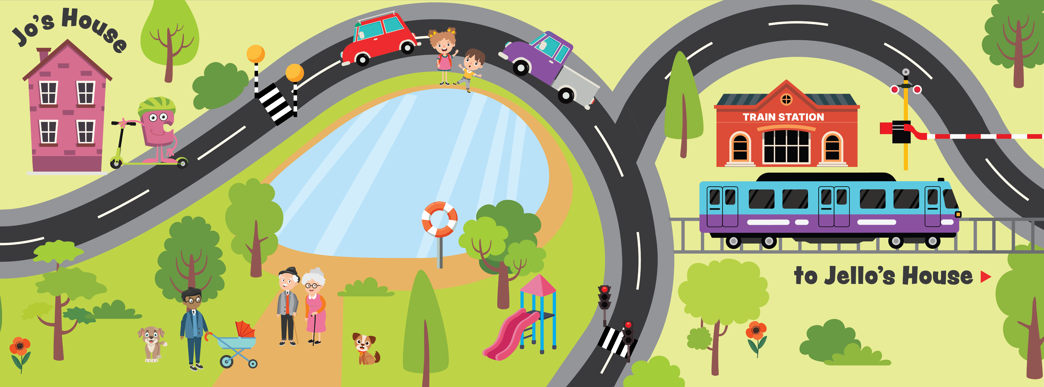
AGES 6-7 - PIECE 4 – STAYING SAFE OUTSIDE
© Jigsaw Education Group
Notes:
New lessons, new graphics – and you will spot them in updated existing content too.

Slide 15
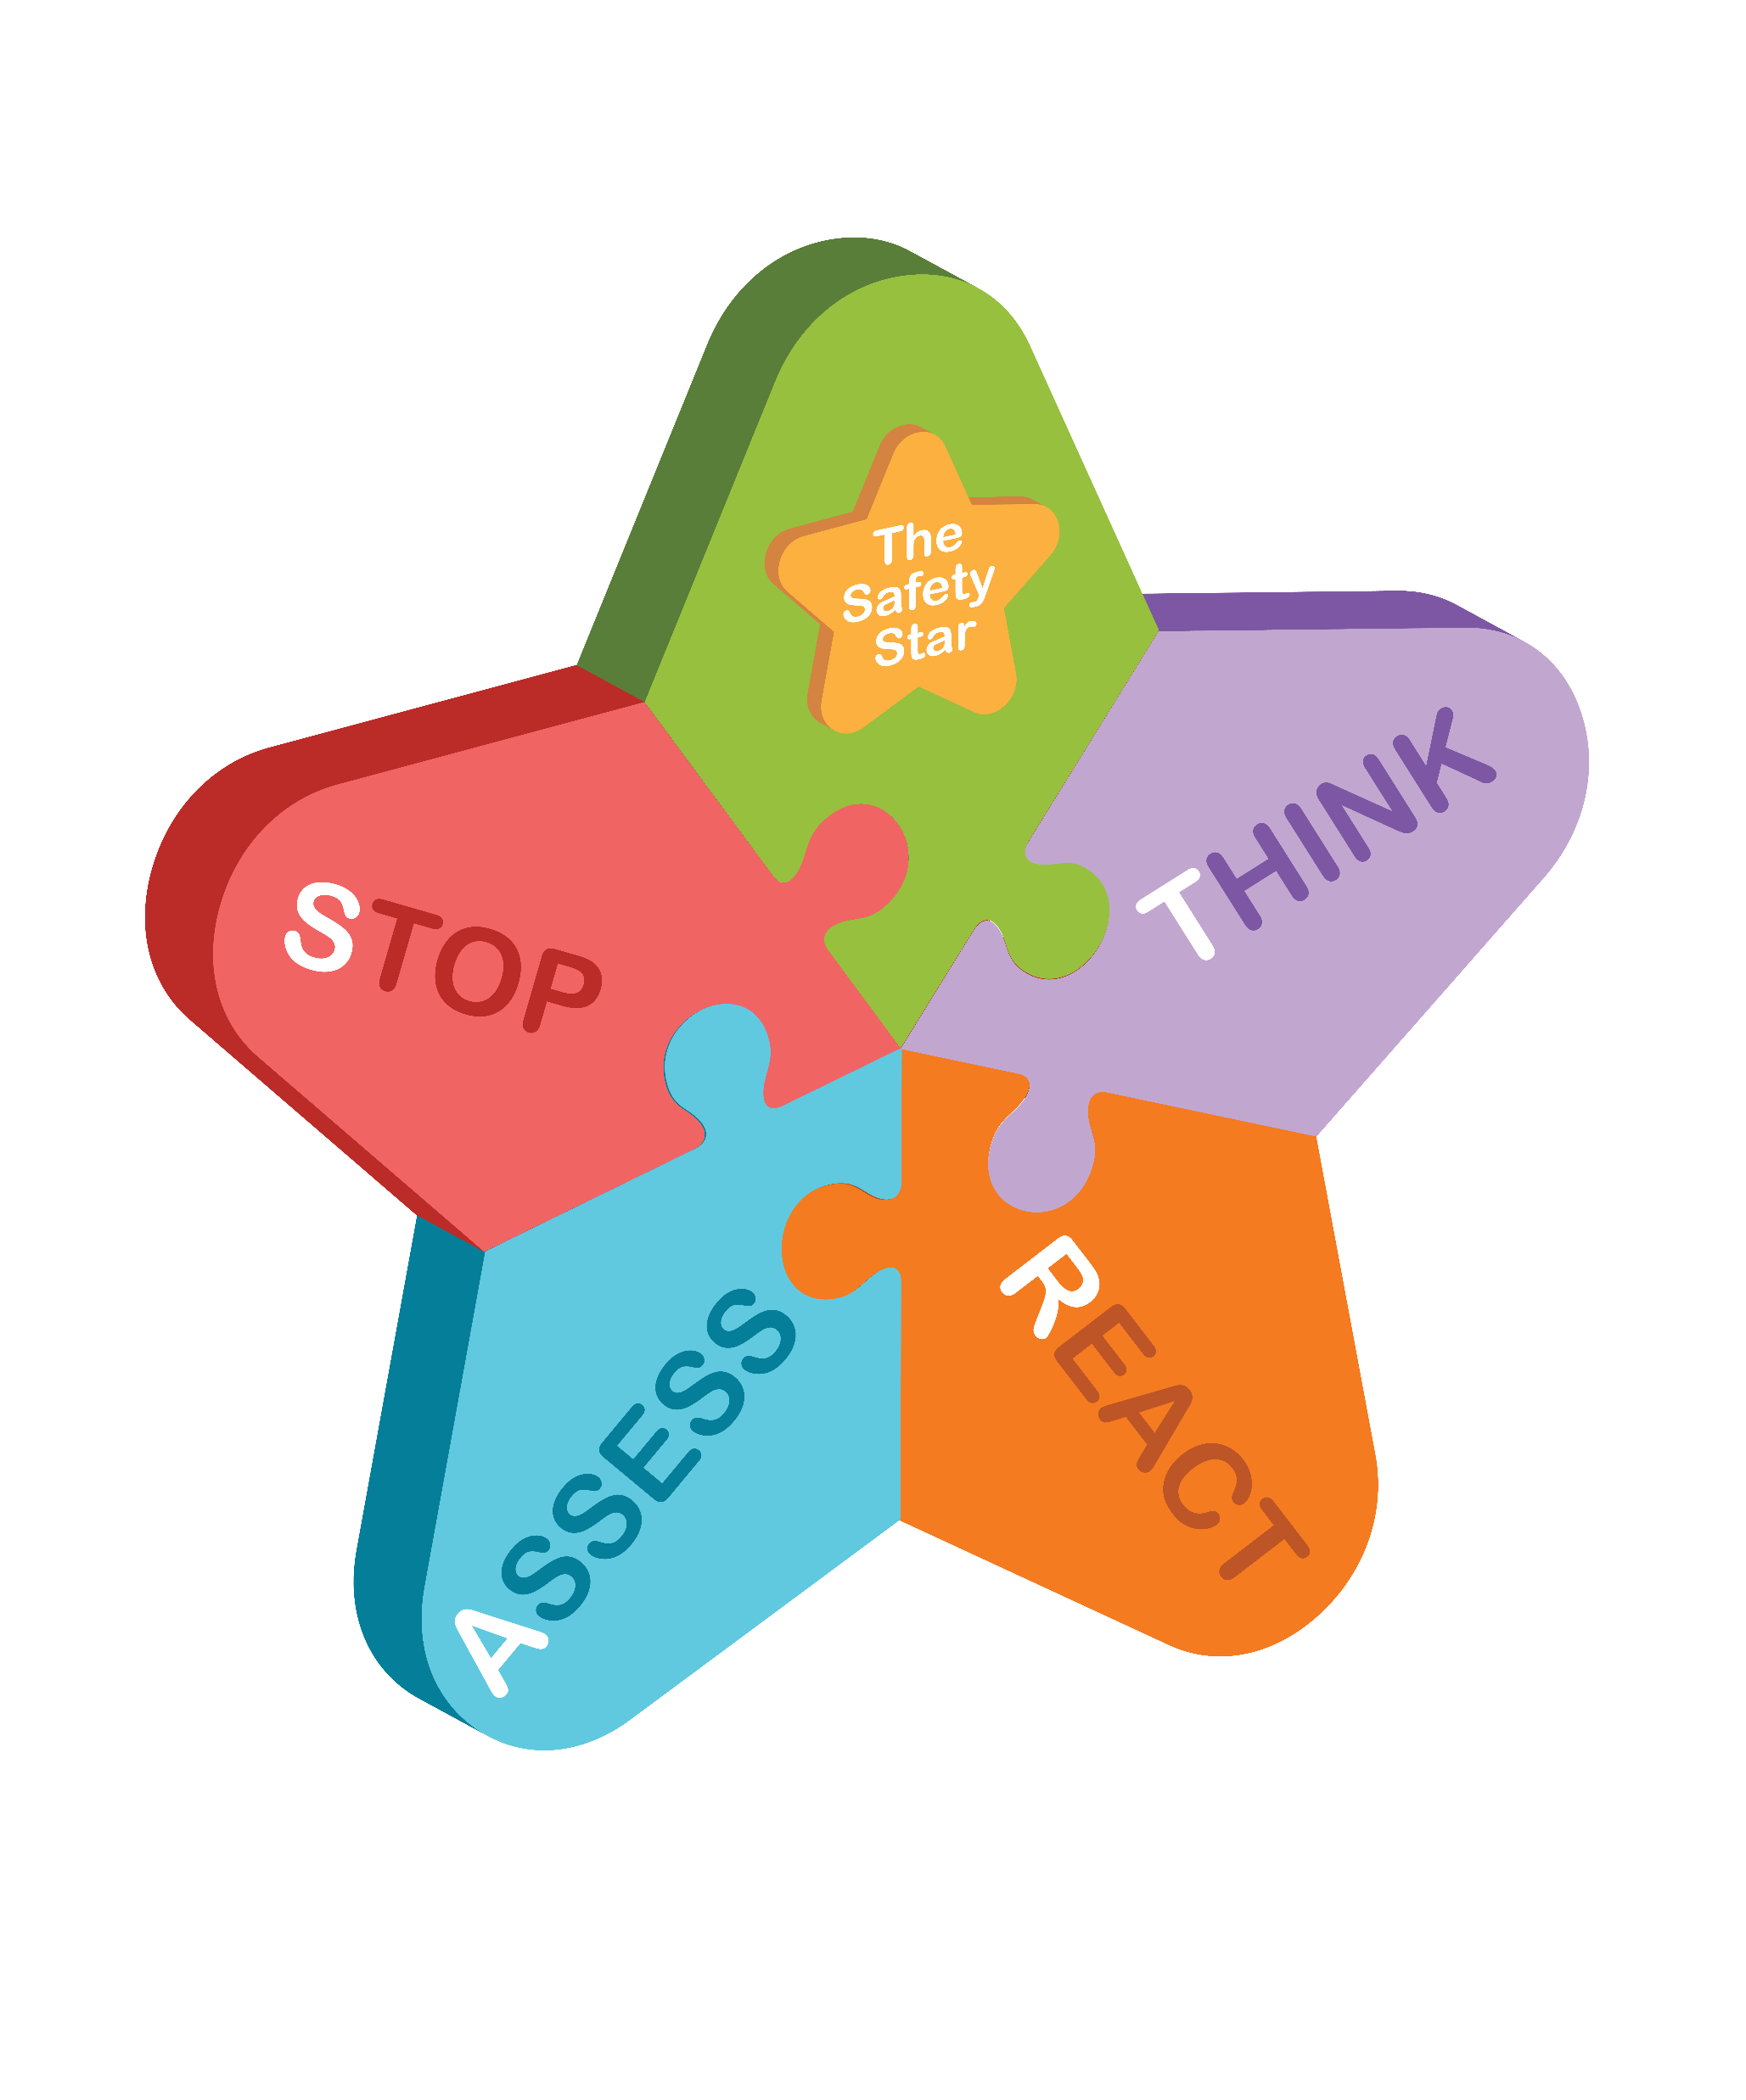
SAFETY EDUCATION
Safety STAR framework: Stop, Think, Assess, React
A consistent decision-making tool used across multiple age groups and contexts
© Jigsaw Education Group
Notes:
One of the biggest areas of change – safety education.
We've introduced the Safety STAR framework – Stop, Think, Assess, React
STOP - Pause before you do anything. Don't rush or panic. Take a breath.
THINK - Work out what's happening. What do you know? What help is needed? Notice your feelings but don't let them take over.
ASSESS - Decide what to do. Is it safe for you to help? Should you get an adult? What's the most helpful thing you can do right now?
REACT - Make your choice and act. You might call 999, fetch help, stay calm, or keep yourself safe. Your reaction depends on the situation.

Slide 16
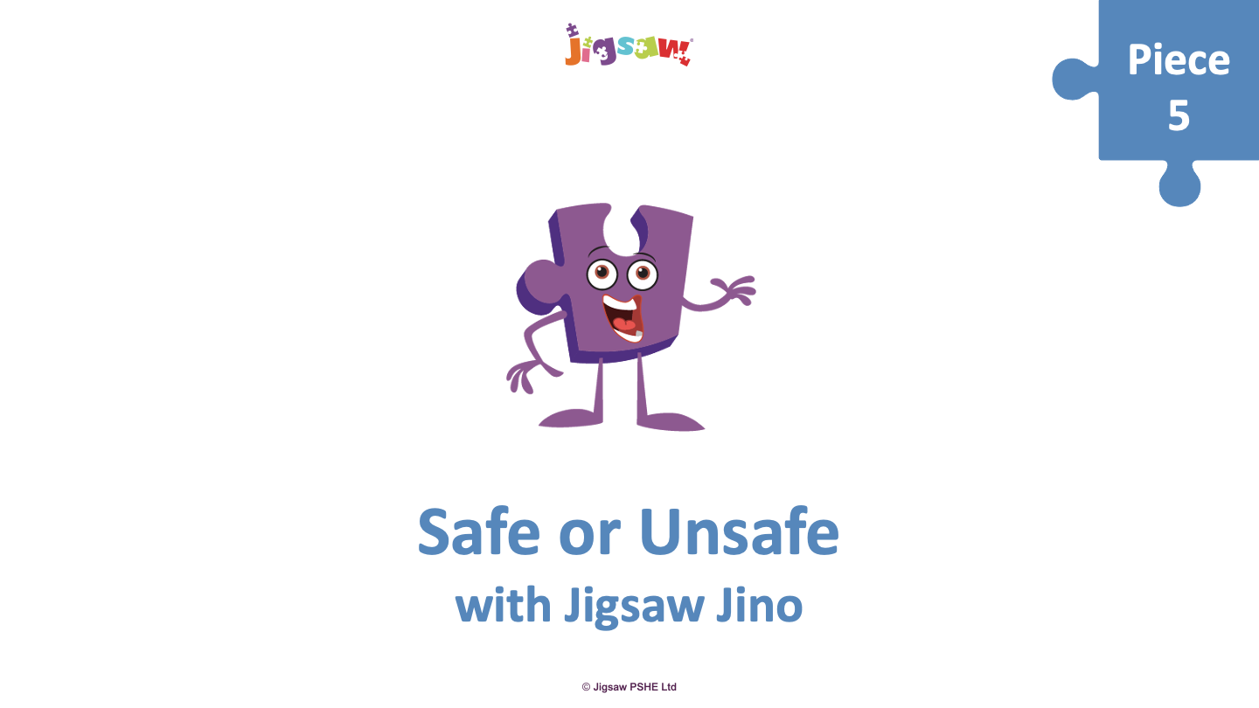
SAFE OR UNSAFE (Ages 7-8)
© Jigsaw Education Group
Notes:
This is the Safe or Unsafe lesson at Ages 7-8 – it's been significantly updated for the new guidance.
In the previous lesson pupils were using the safety star
The lesson introduces the Water Safety Code, teaches children about cold water shock, which is something many adults don't fully understand either.
Children use the Safety STAR framework to think through scenarios – Stop, Think, Assess, React – and learn when and how to call emergency services.
It's a really practical lesson with content children can genuinely apply.

Slide 17
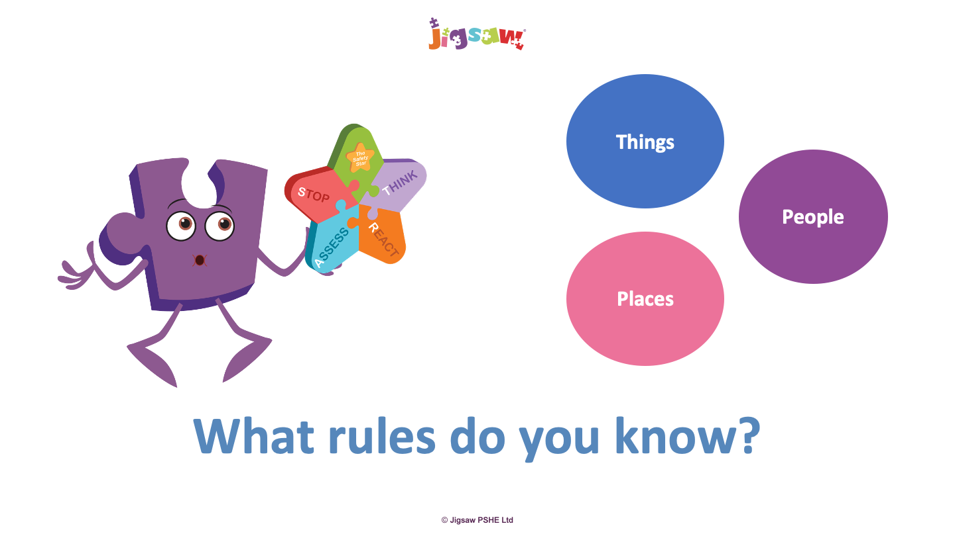
Safety star revisited and pupils explore similarities between different safety rules they know:
© Jigsaw Education Group

Slide 18
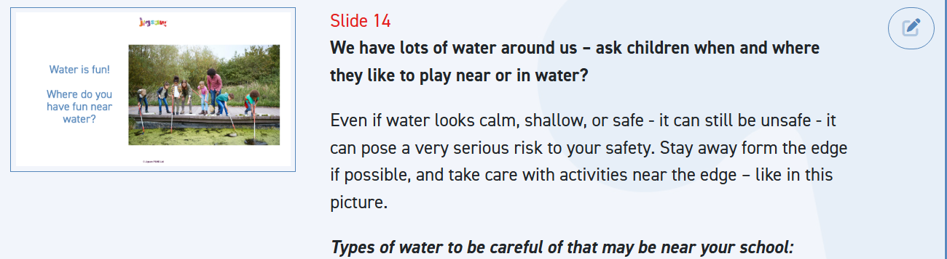
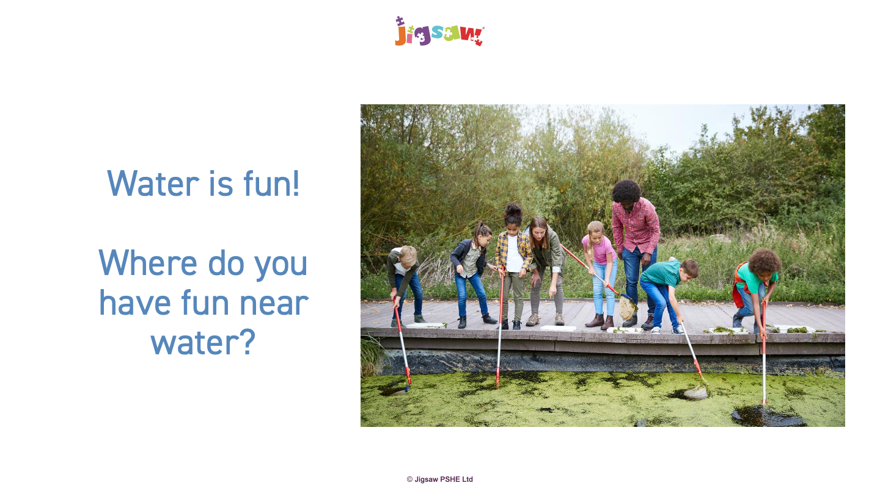
Teaching designed to focus on pupils’ experience
© Jigsaw Education Group

Slide 19
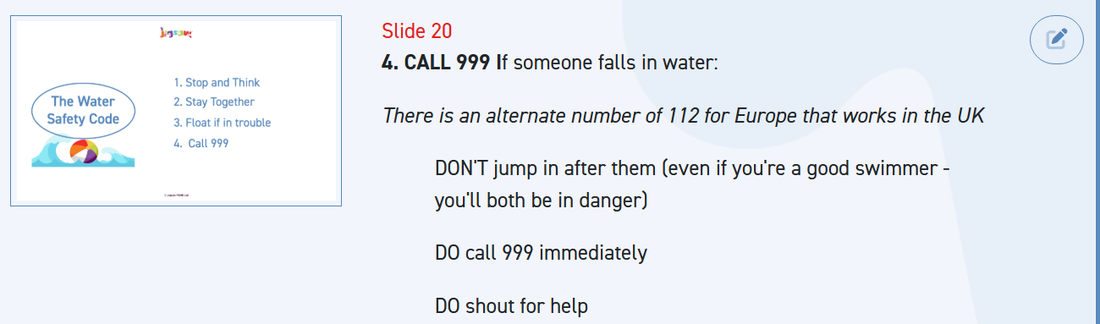
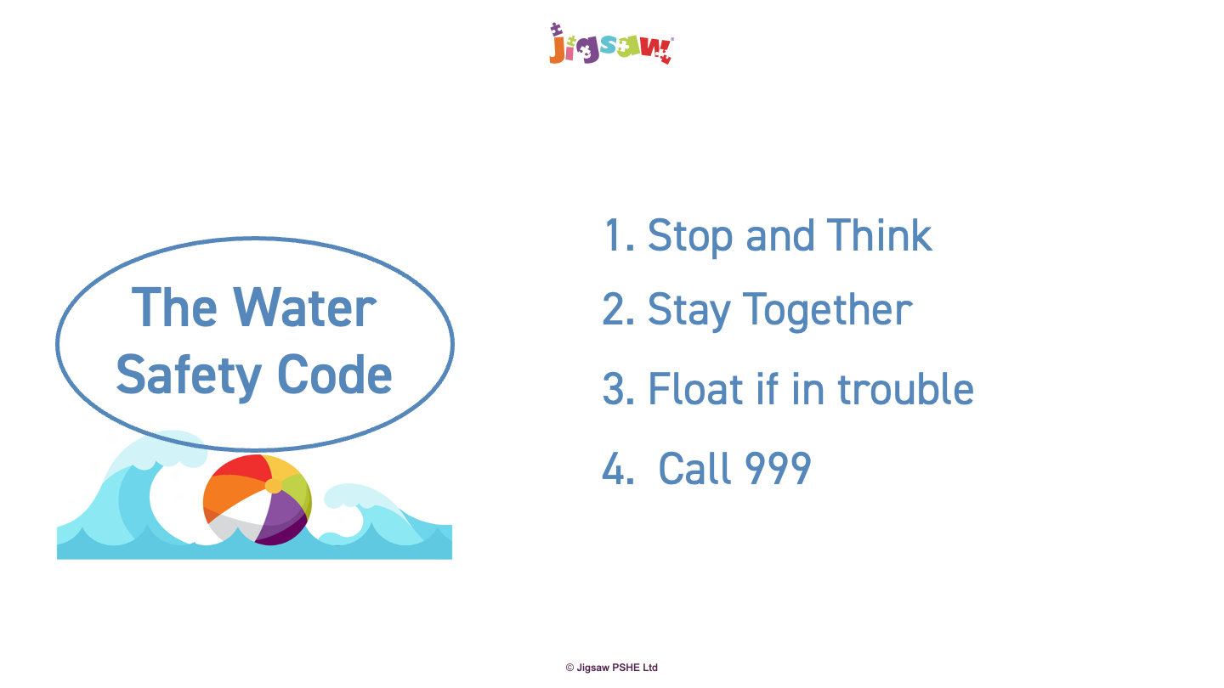
Links strategies for keeping safe to water safety rules
© Jigsaw Education Group

Slide 20
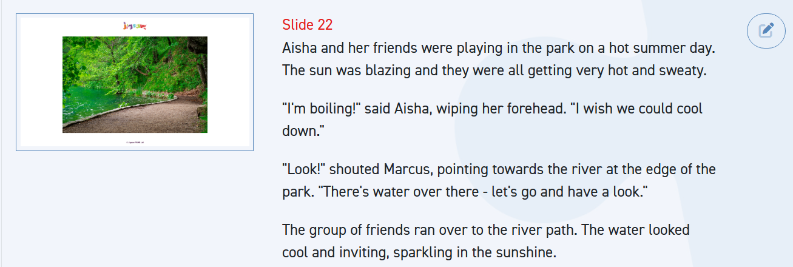
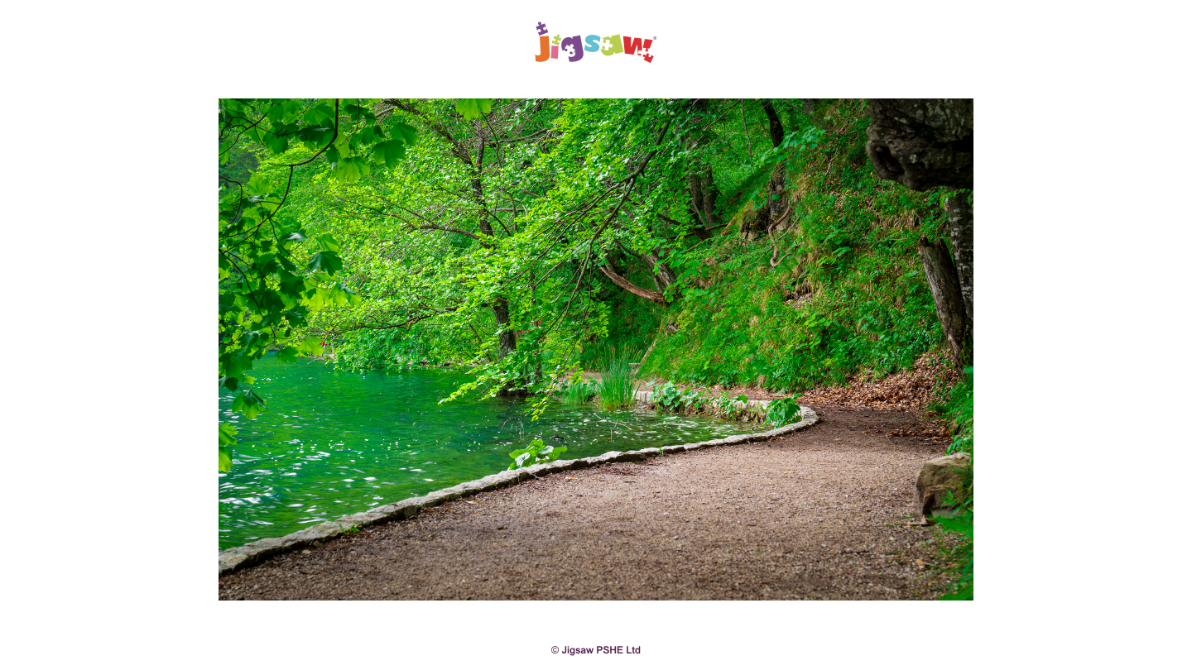
Whole class exploration of decision making through story
© Jigsaw Education Group

Slide 21
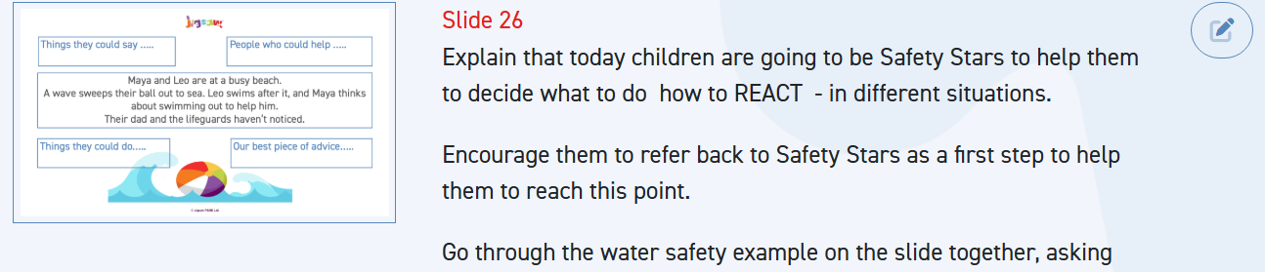
Small group exploration/discussion of different scenarios to develop understanding and skills
© Jigsaw Education Group

Slide 22
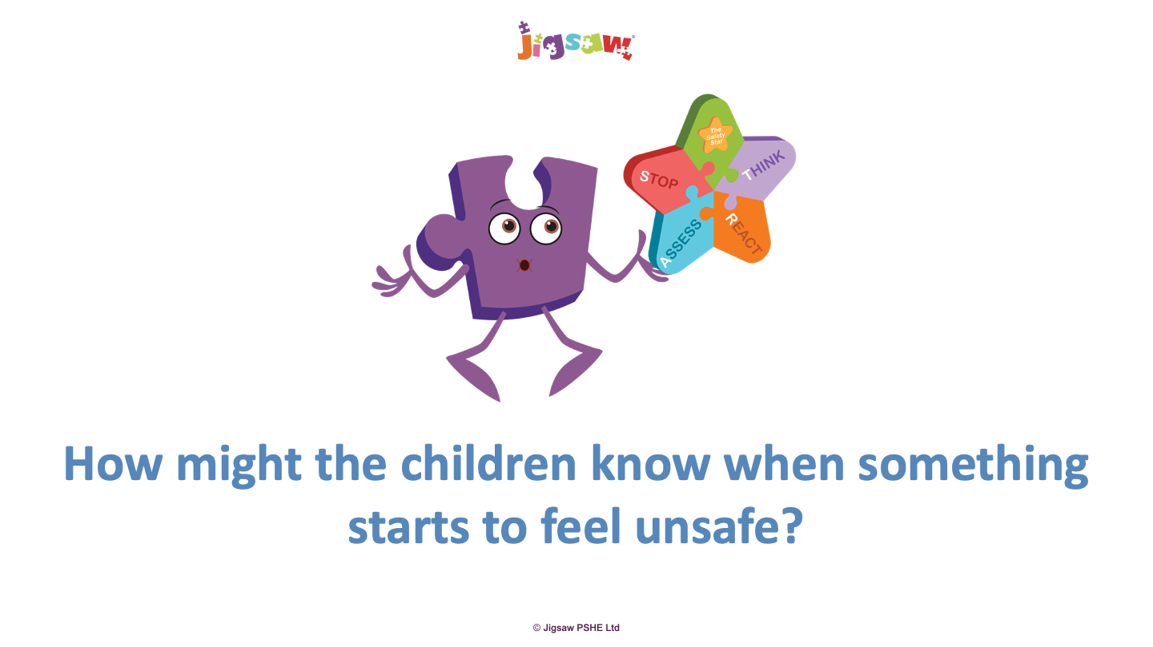
Links to how we might feel physically and emotionally
© Jigsaw Education Group
Notes:
The safety star is also linked to learning about other aspects of safety – online safety, decision making in social situations

Slide 23




CHANGING ME
Sex education content now starts in Year 5 (removed from Year 4)
Reduced overlap between statutory Health and non-statutory Sex Education
Puberty content restructured for gentler progression
Updated graphics for reproductive systems
NEW personal hygiene content
NEW Unique Me content for Ages 8-9
© Jigsaw Education Group
Notes:
Changing Me has had a lot of structural changes in KS2
The headline change is that sex education content – meaning conception and birth – now starts in Year 5. It is now in Year 4 in line with the 2025 DfE recommendation.
This has allowed for restructuring e the puberty content across Years 3, 4, 5 and 6 for a gentler progression.
There is a much clearer separation between what's statutory Health Education – which includes puberty – and what's non-statutory Sex Education. This helps with parent communication and managing withdrawal requests.

Slide 24
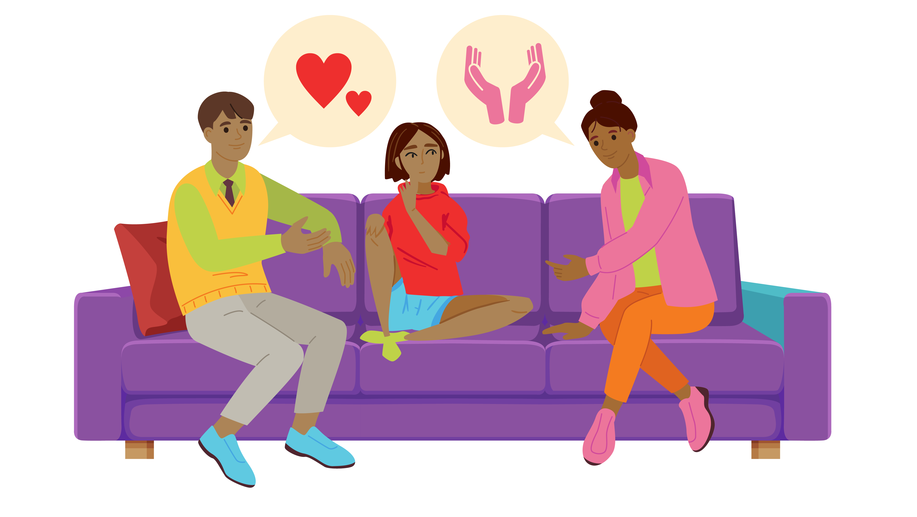
CHANGING ME
Lower KS2
Age | Piece | Change | Summary
7 - 8 | P2 & P3 | Restructured | Updated puberty content to fill gap as previous P2 removed
7 - 8 | P4: Keeping Ourselves Clean | New lesson | Personal hygiene linked to growing and changing
8 - 9 | P1: Unique Me | New lesson | Identity, heritage, values and personal choices
8 - 9 | P2 & P3: | Restructured | Sex ed content removed; updated puberty content
8 - 9 | P3: Being Part of a Family | New lesson | Family structures, inner circle of trusted people, support signposting
© Jigsaw Education Group
Notes:
This Puzzle has significant changes, including four new lessons, restructured puberty content, and the removal of sex education from Year 4 (now beginning in Year 5).
Puberty content across Ages 7-8, 8-9, 9-10 and 10-11: Content that may be considered sex education in some schools has been reduced and lower key stage 2 content adjusted to reflect how non-statutory sex education lessons now begin in Year 5. New images have been included in puberty lessons, especially for schools choosing not to use animations.
Additional updates across this Puzzle include updated graphics for reproductive systems and enhanced support signposting throughout.
Sex ed more clearly separated from puberty

Slide 25

CHANGING ME
Upper KS2
Age | Piece | Change | Summary
8 -9 | P2: Puberty and Menstruation | Renamed | Previously "Puberty for Girls"; updated vocabulary
9-10 | P3: Inside Body Changes | Moved and updated | Reordered in Puzzle; new graphics for reproductive system
10-11 | P2 & P3: | Restructured | Sex ed content removed; updated puberty content, new images
10-11 | P1 & P2 | Significant change | Enhanced self-image content and positive emotional language, added personal hygiene
© Jigsaw Education Group
Notes:
At Ages 9-10, the puberty lessons have been reordered and updated with new graphics, and there's another new hygiene lesson.
At Ages 10-11, we've added much more content to support self-image and positive emotional language.

Slide 26
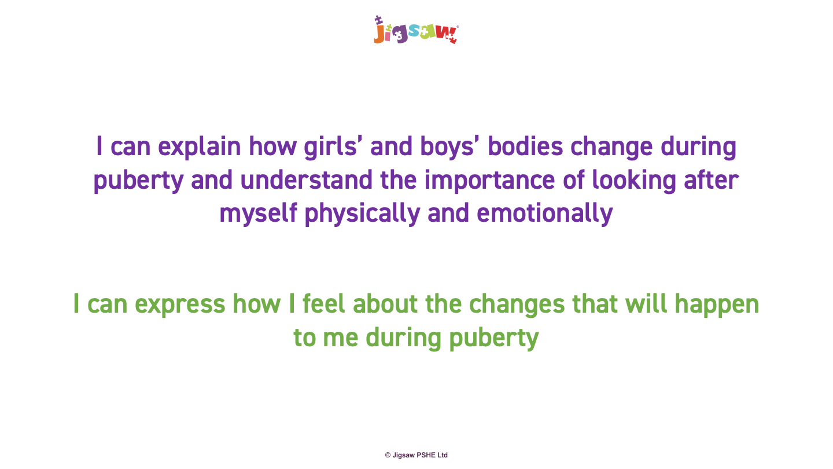
AGE 10-11 - P2 – PUBERTY
© Jigsaw Education Group
Notes:
Example of changes - this lesson has same title – but has been updated to build on personal hygiene content in previous year groups;

Slide 27
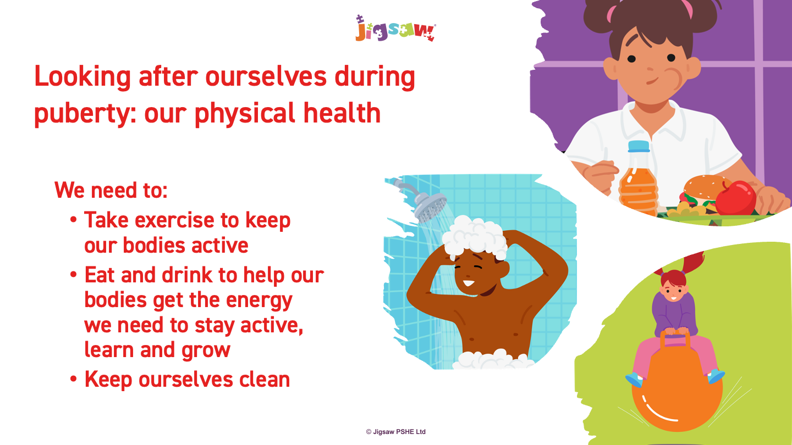
AGE 10-11 - P2 - PUBERTY
© Jigsaw Education Group
Notes:
Reinforcing key messages

Slide 28
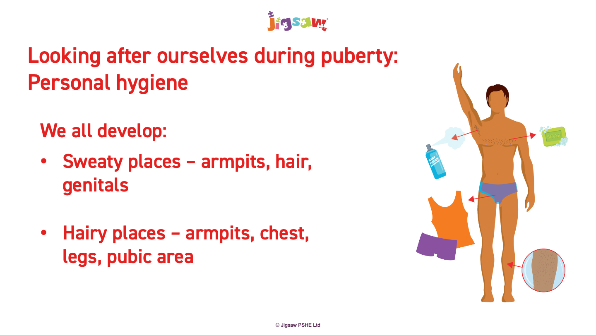
AGE 10-11 - P2 – PUBERTY
© Jigsaw Education Group
Notes:
Normalising developmental stages

Slide 29
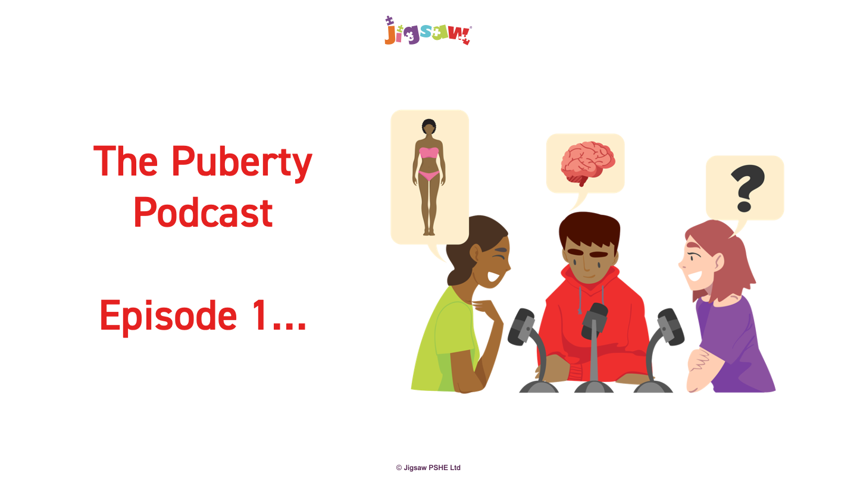
AGE 10-11 - P2 – PUBERTY
© Jigsaw Education Group

Slide 30
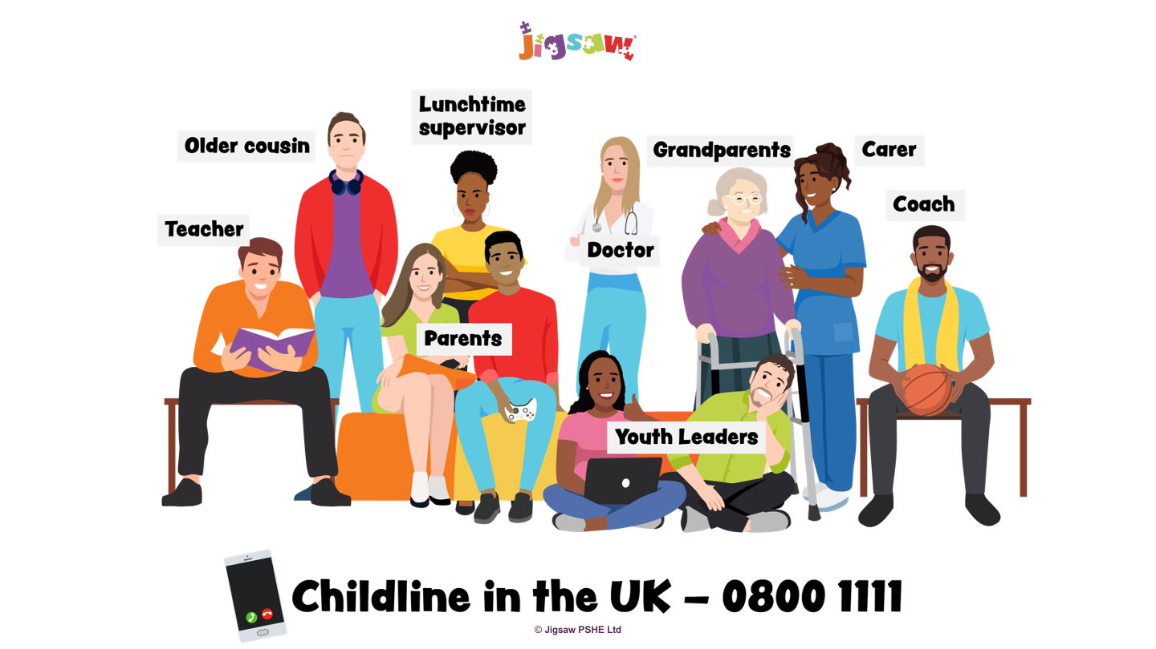
AGE 10-11 - P2 – PUBERTY
© Jigsaw Education Group
Notes:
Theme revisited through programme – Jigsaw encourages us to look at these and personalise to our school – across all puzzles

Slide 31



UPDATED ACROSS THE PROGRAMME
Health protection: vaccinations, viruses, sun safety, nicotine pouches
Personal hygiene: enhanced throughout, especially in Healthy Me and Changing Me
Safeguarding: persistent help-seeking, identifying trusted adults, signposting to support
Protected characteristics: more explicit in upper KS2, supporting Ofsted expectations
© Jigsaw Education Group

Slide 32
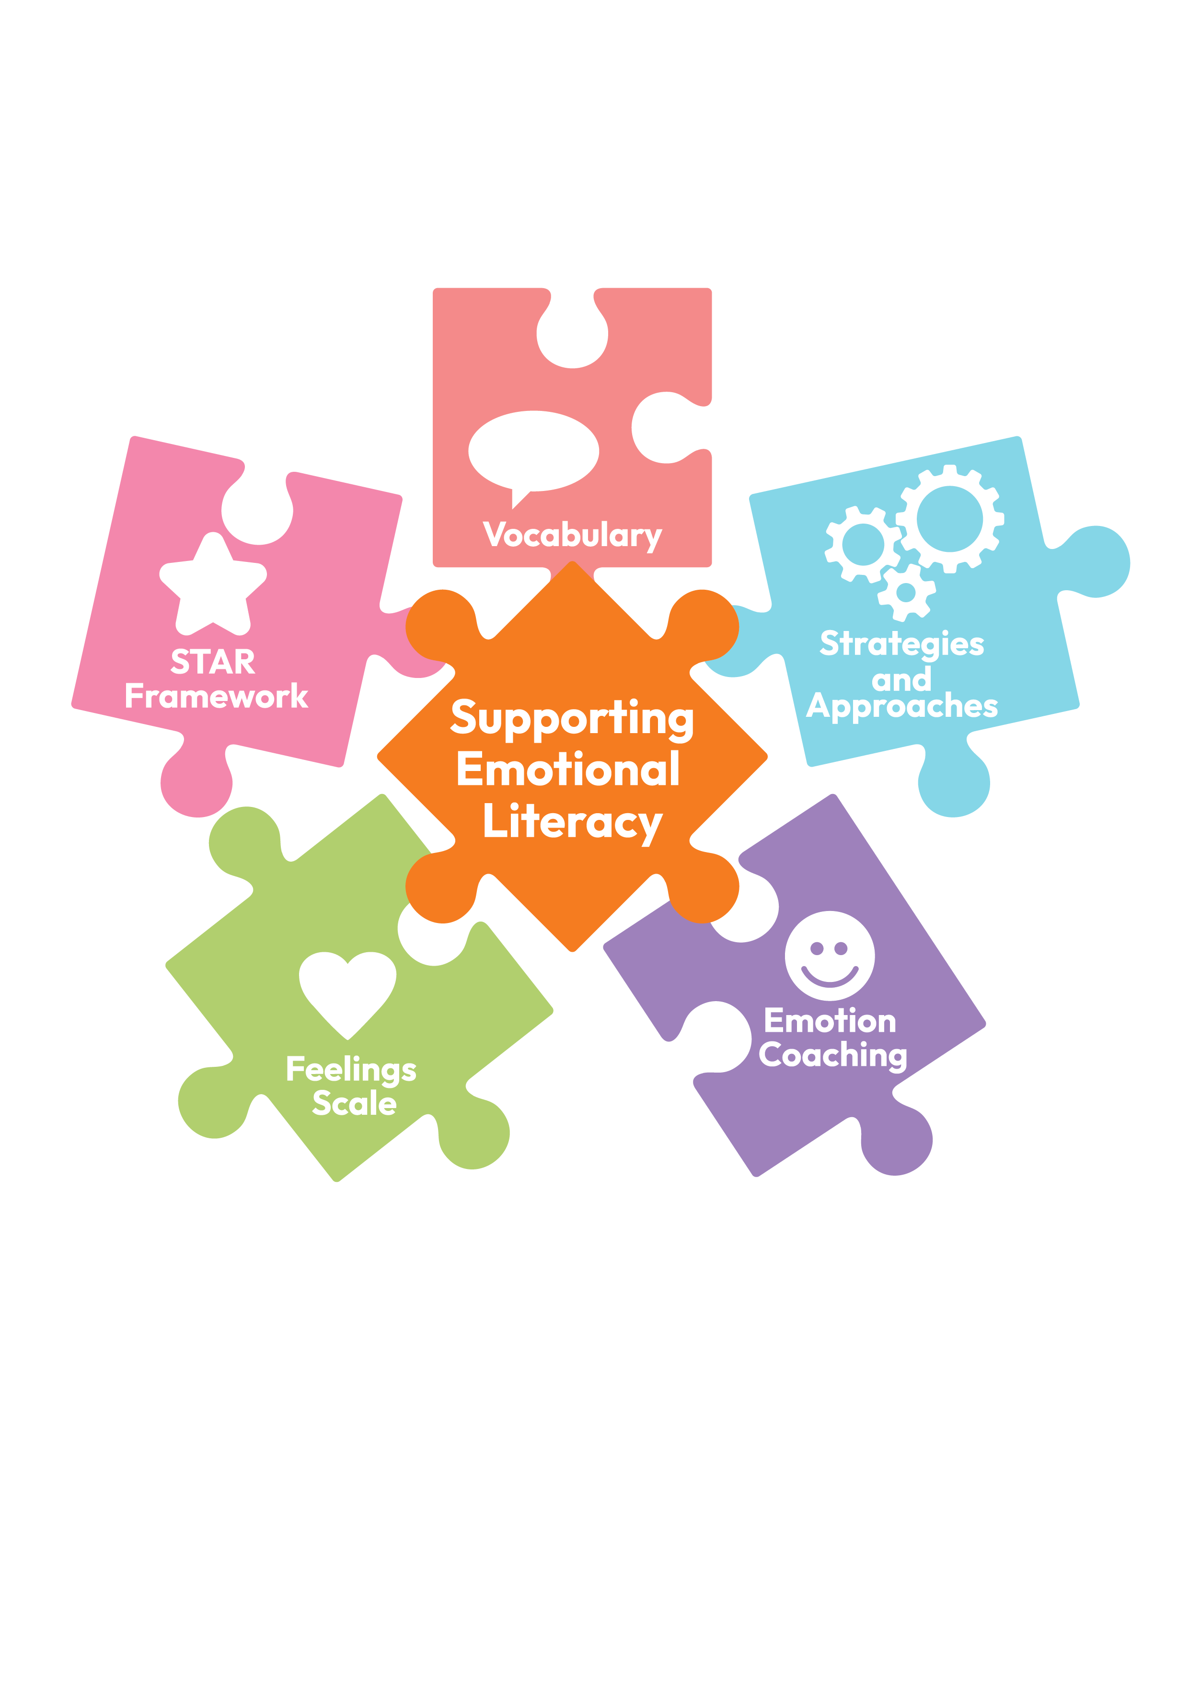



EMOTIONAL LITERACY: NEW MATERIALS
NEW supporting resources to enhance and develop emotional literacy through Jigsaw PSHE
Teacher Guidance (KS1, LKS2, UKS2)
Progressive emotional vocabulary linked to each Jigsaw Puzzle, including core and more complex emotions
Feelings and intensity scale to help children recognise how strong an emotion feels and how it can change
Emotion coaching prompts to help adults model validating, supportive emotional language in the moment
The STAR Framework to provide a shared, whole-school language for self-regulation
Additional resources for classroom display
© Jigsaw Education Group
Notes:
Every Jigsaw puzzle is intentionally planned to include opportunities to develop emotional literacy, supporting children to name, understand, and express feelings in age-appropriate ways. These additional emotional literacy resources enable teachers to extend and build upon Jigsaw lessons further, offering flexible opportunities to deepen children's emotional understanding and use of emotional language from ages 5-11 years, building on vocabulary introduced at Ages 3-5 years (as shown in the whole-school progression chart).
The resources enable teachers to further develop children’s emotional literacy within Jigsaw lessons and everyday classroom life, deepening their emotional understanding and expanding

Slide 33


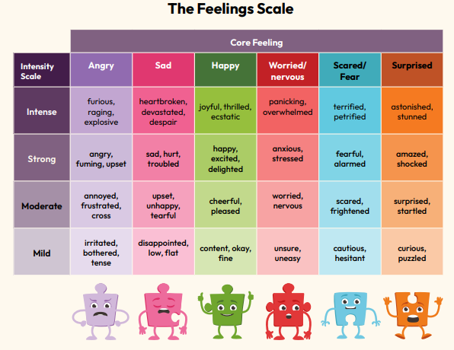
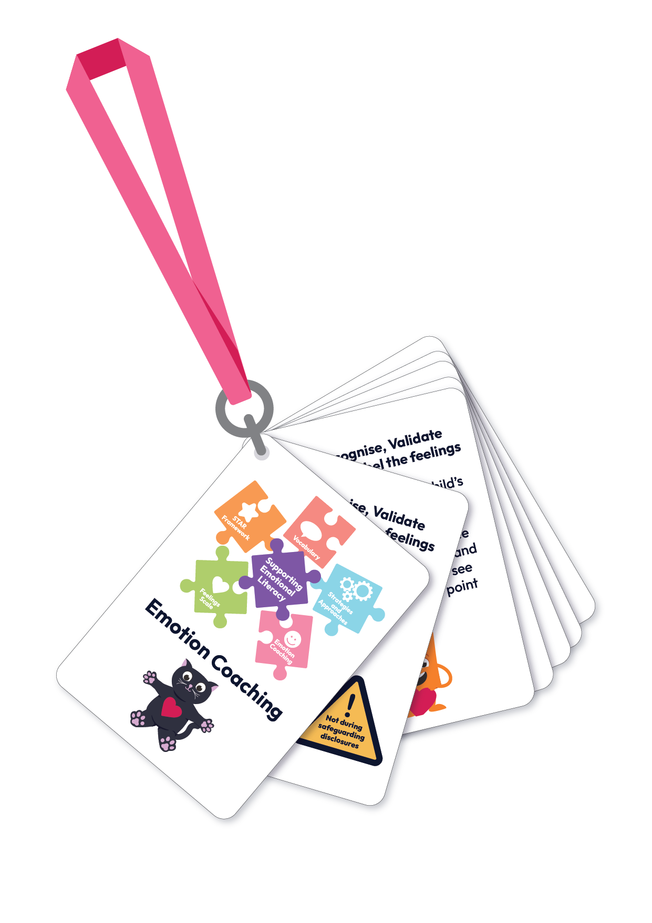
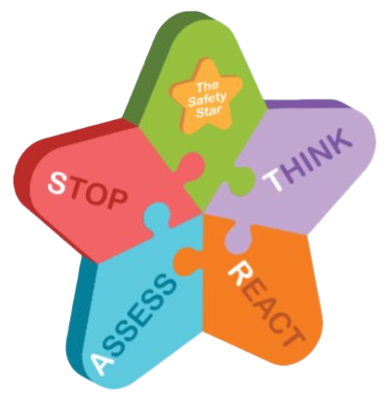
EMOTIONAL LITERACY: NEW MATERIALS
NEW supporting resources to enhance and develop emotional literacy through Jigsaw PSHE
© Jigsaw Education Group
Notes:
New materials found in Jigsaw+ Jigsaw

Slide 34

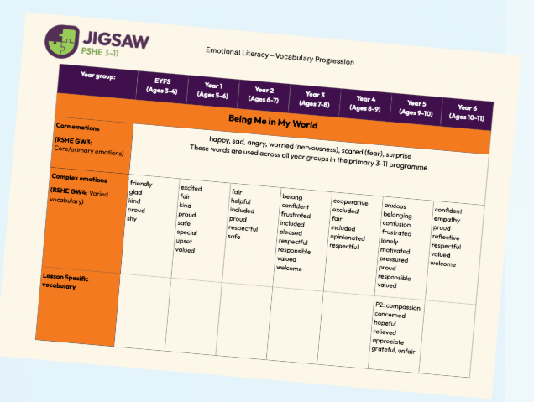

EMOTIONAL LITERACY: VOCABULARY
Core emotions
Complex emotions
Lesson specific
Self-regulation vocabulary
Executive-functioning vocabulary

Slide 35
ACCESSING YOUR UPDATED RESOURCES
Everything you need, and where to find it

Slide 36
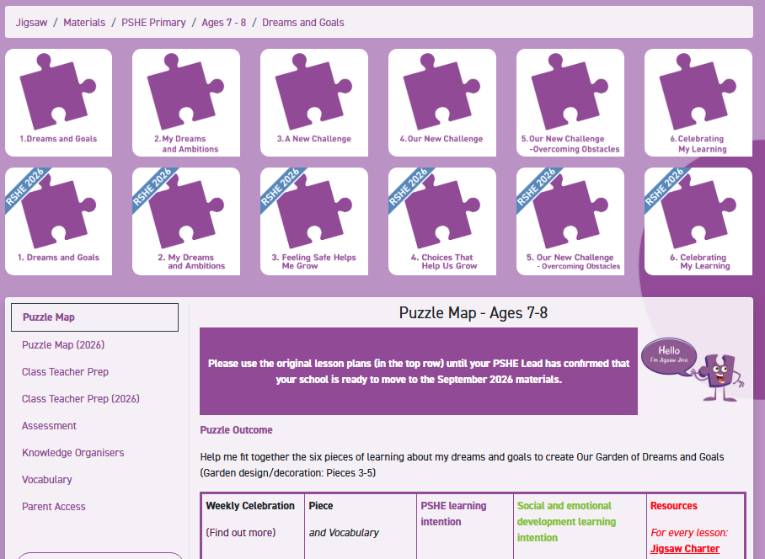
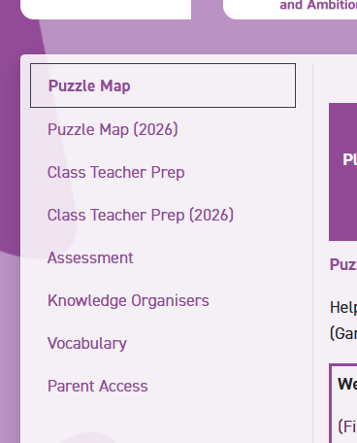
LESSON PLANS: current and RSHE 2026 ready
Your current lesson plans remain on the top line – keep using these until you are RSHE 2025 ready
2026 updated content sits below – RSHE sash
Puzzle maps and other supporting 2026 content being added
© Jigsaw Education Group
Notes:
You'll want to be clear with colleagues: keep using the current materials until your school has reviewed the new content and updated your policy. The new Puzzle maps show you exactly what's changed in each Puzzle so you can plan your transition.

Slide 37
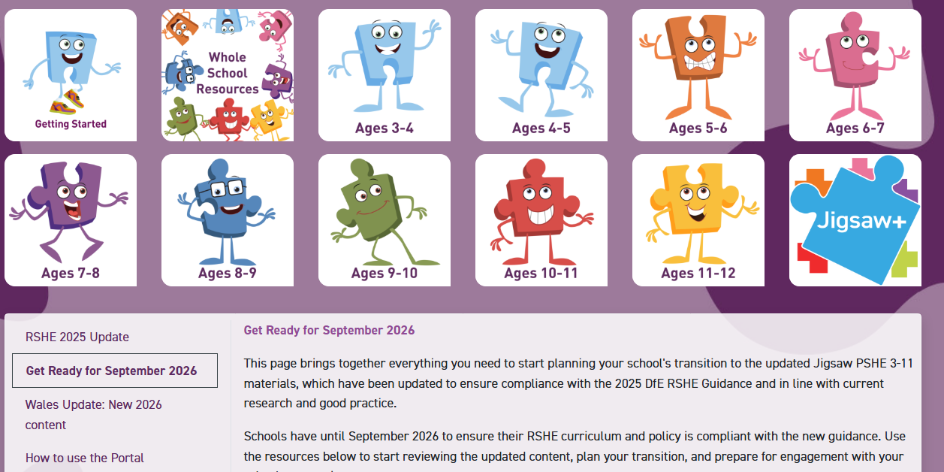

GET READY FOR SEPTEMBER 2026
Key documents to support your transition
Notes:
Click in circle for link to this page on portal

Slide 38
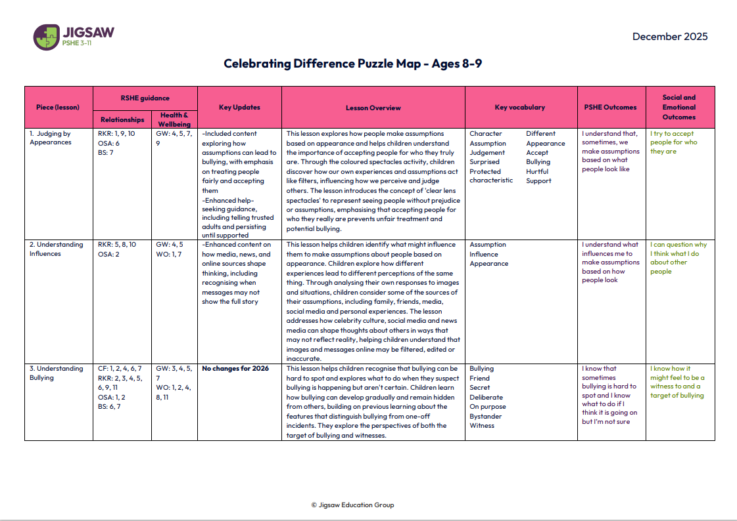
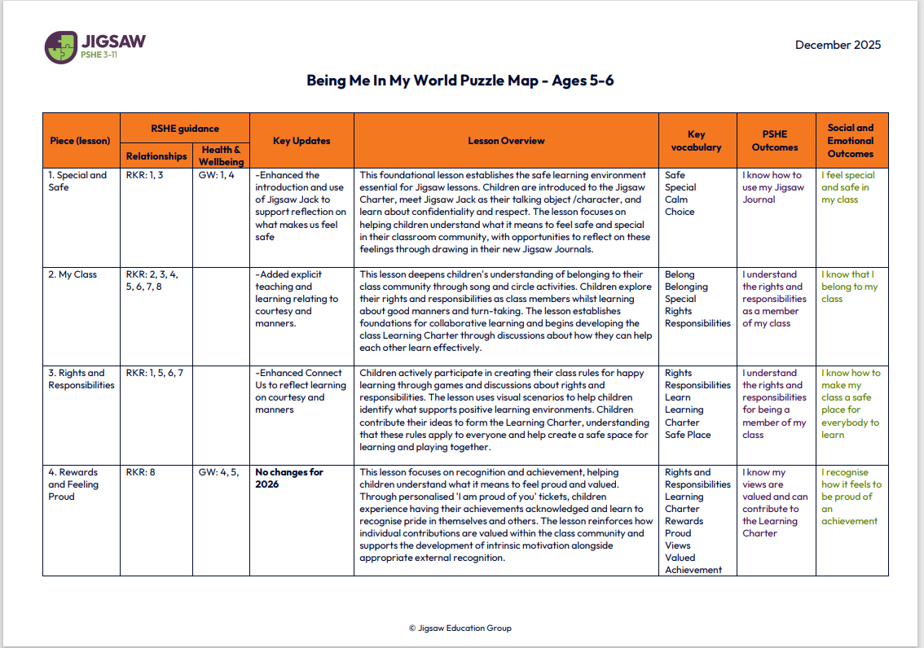
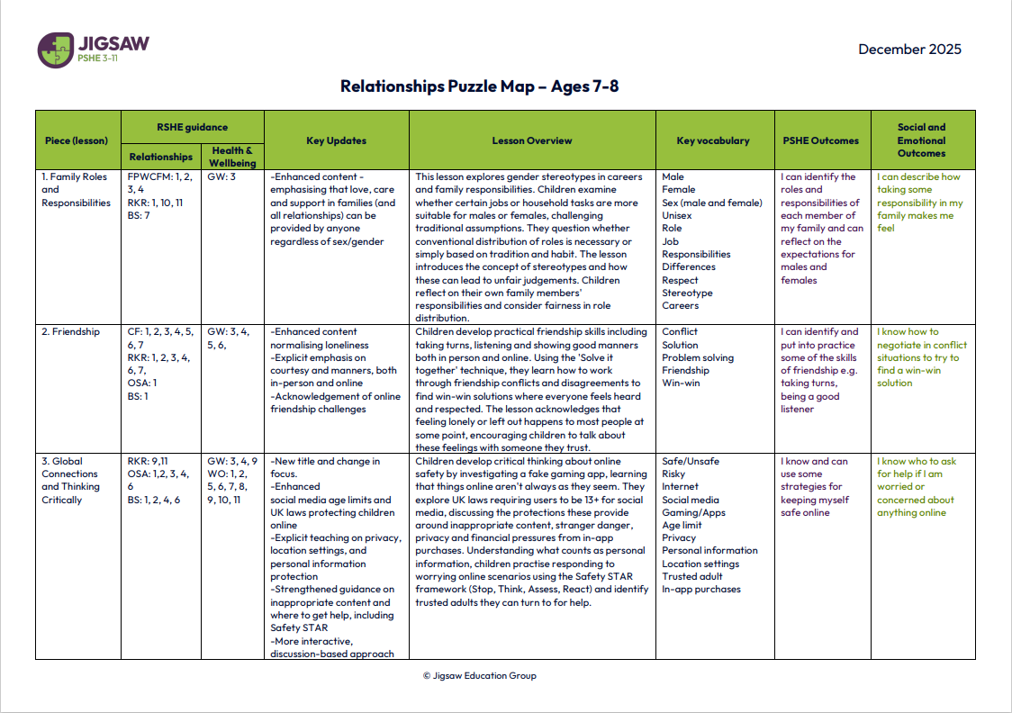
DETAILED PUZZLE MAPS
Available now
© Jigsaw Education Group
Notes:
Detailed Puzzle Maps I the Get RSHE ready for 2026 section – and also alongside the 2025 versions of these in the Optimise area – click on any of the docs above for a link to these,

Slide 39
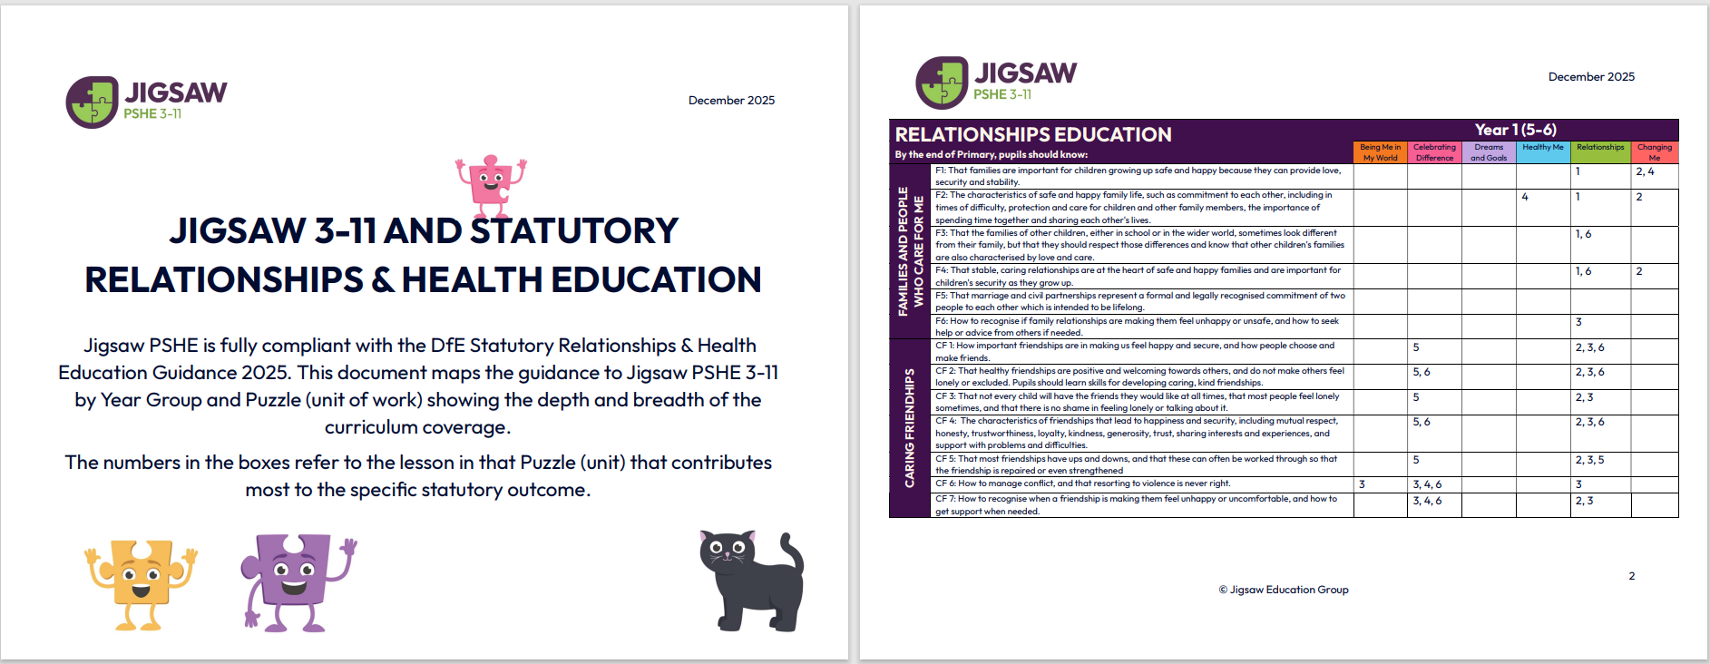
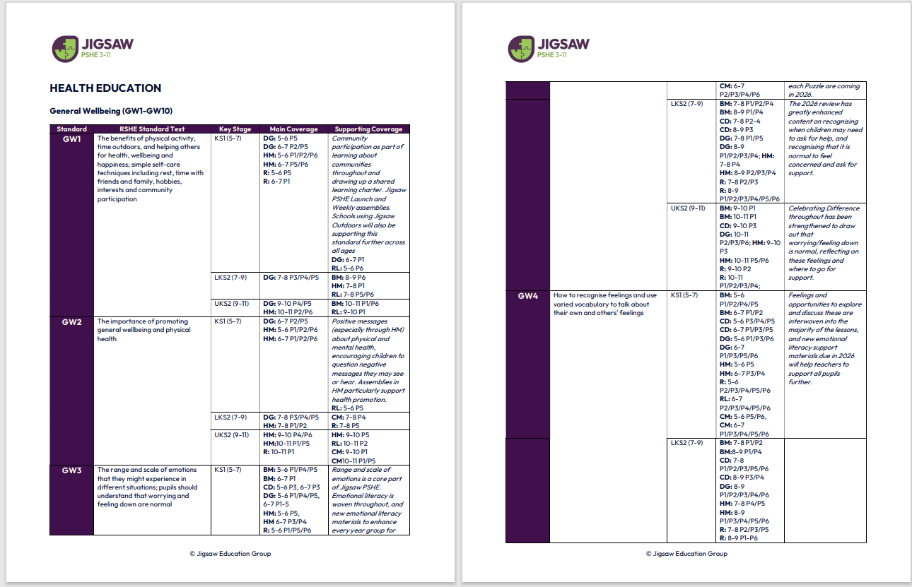
NEW MAPPING AND GUIDANCE
Ready now:
Snapshot
RSHE - showing each Puzzle’s contribution
RSHE - more guided version showing each standard and overview across programme
© Jigsaw Education Group

Slide 40
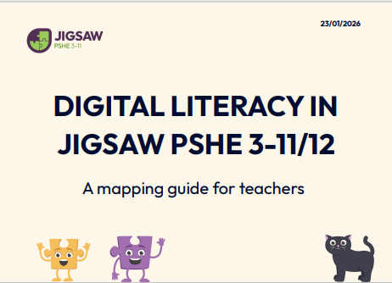
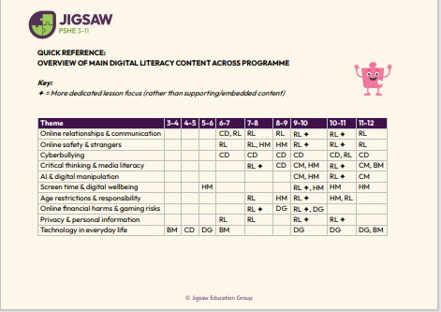
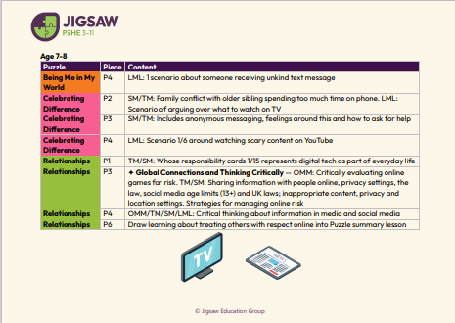
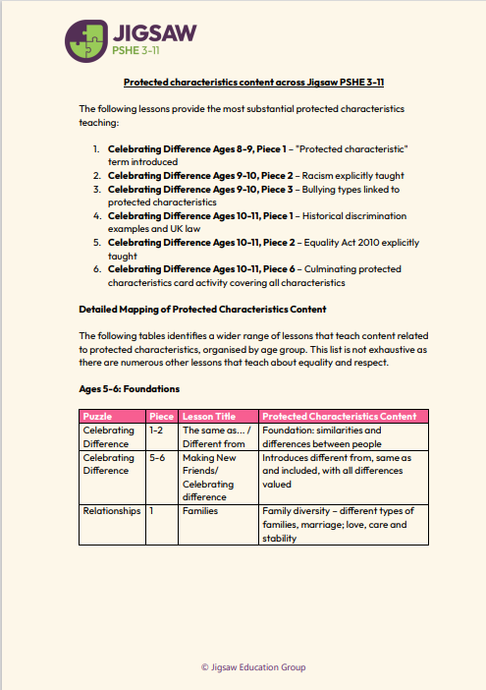
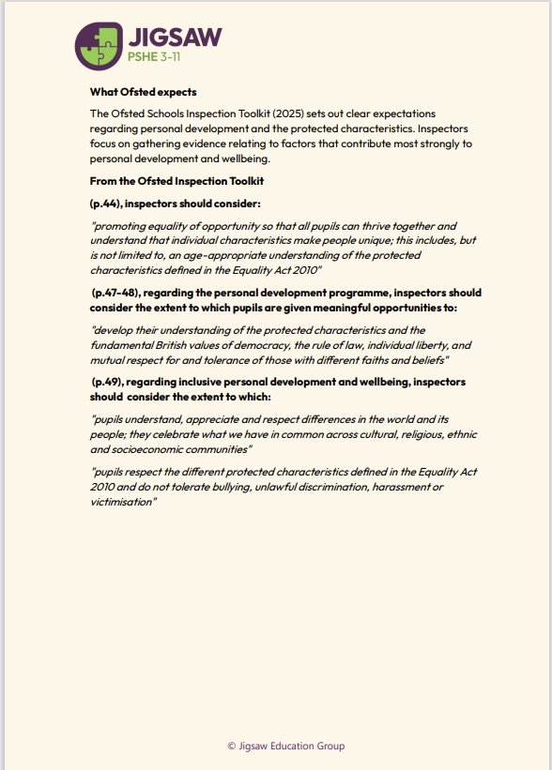
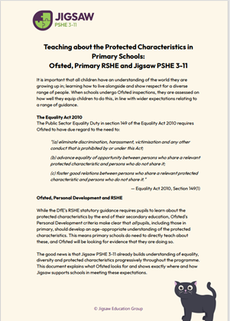
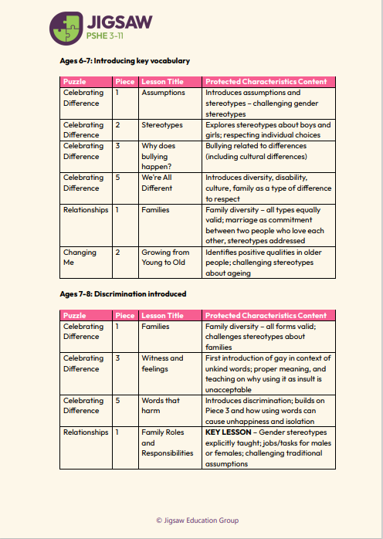
UPDATED DOCUMENTS
Ready now in the Mapping section:
Updated digital literacy document – revised for current expectations
Protected characteristics and Ofsted expectations – updated article with our approach mapped out
© Jigsaw Education Group
Notes:
In the Mapping section, you'll find updated documents that go beyond just the RSHE guidance.
The digital literacy document has been revised. And importantly, we've updated our article on protected characteristics and Ofsted expectations.

Slide 41
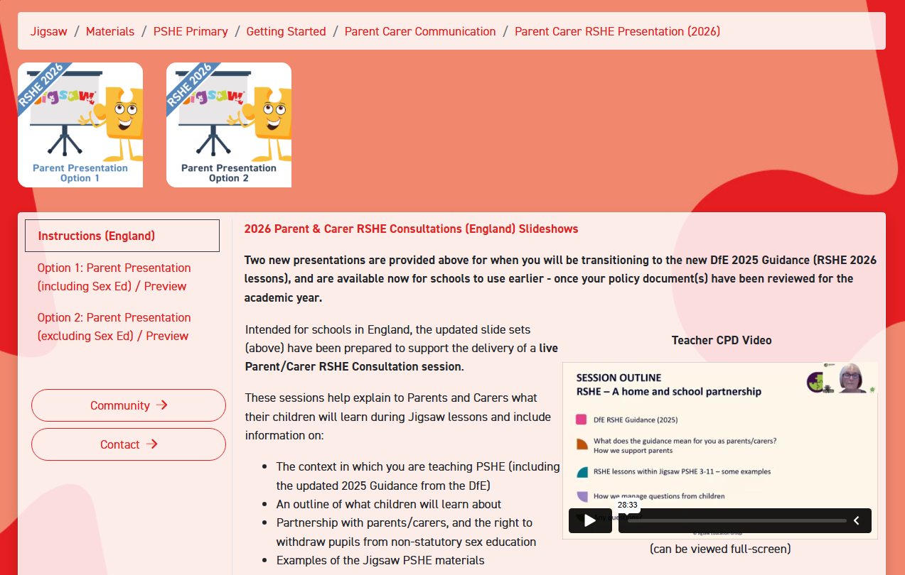
PARENT/CARER PRESENTATION
Updated presentation
Designed for parent/carer live information evenings
Sample demo available to show you how it might look
© Jigsaw Education Group
Notes:
We've updated the parent presentation with a particular focus on the summer term content in Relationships and Changing Me – these are usually the areas parents have most questions about.
There's a sample demo so you can see how it might look before you adapt it for your school. This is designed for parent information evenings and can be tailored to your context.

Slide 42
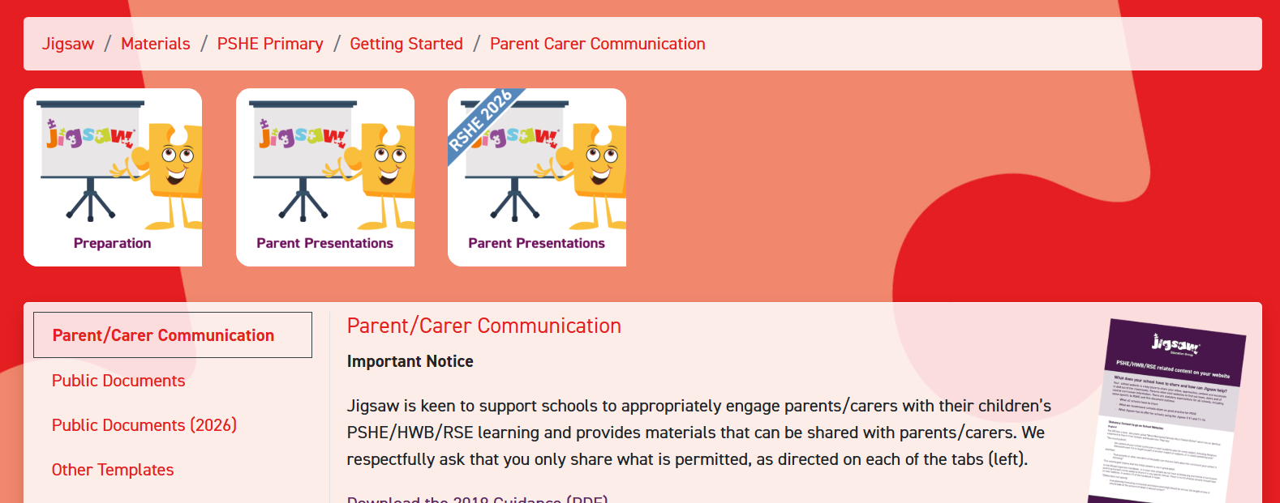
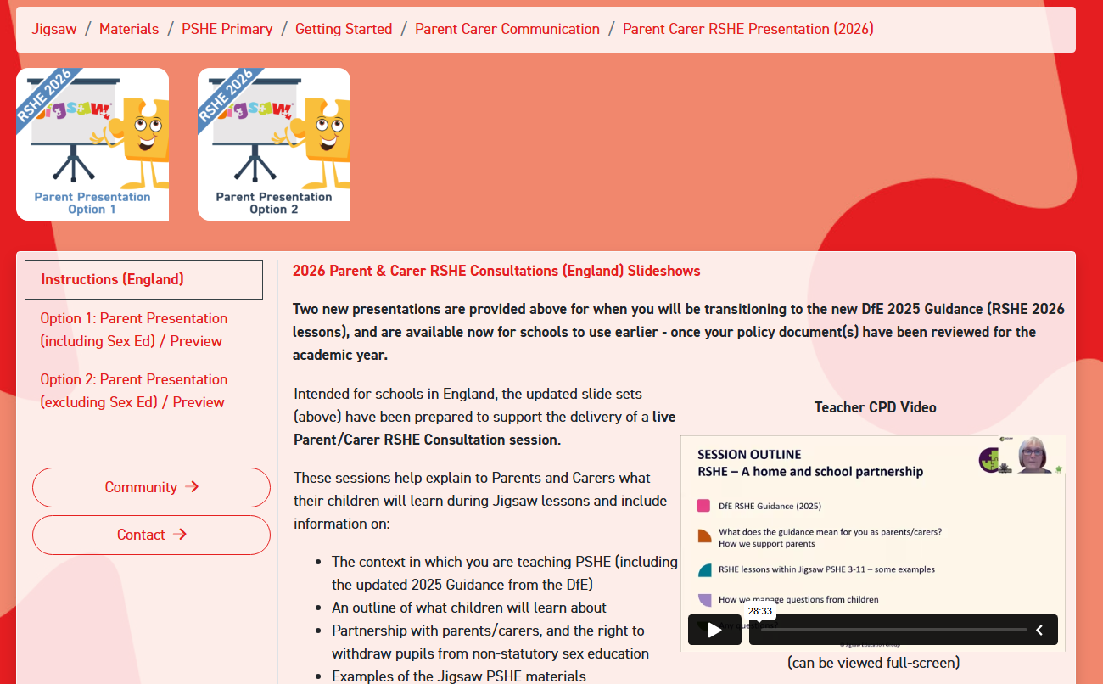
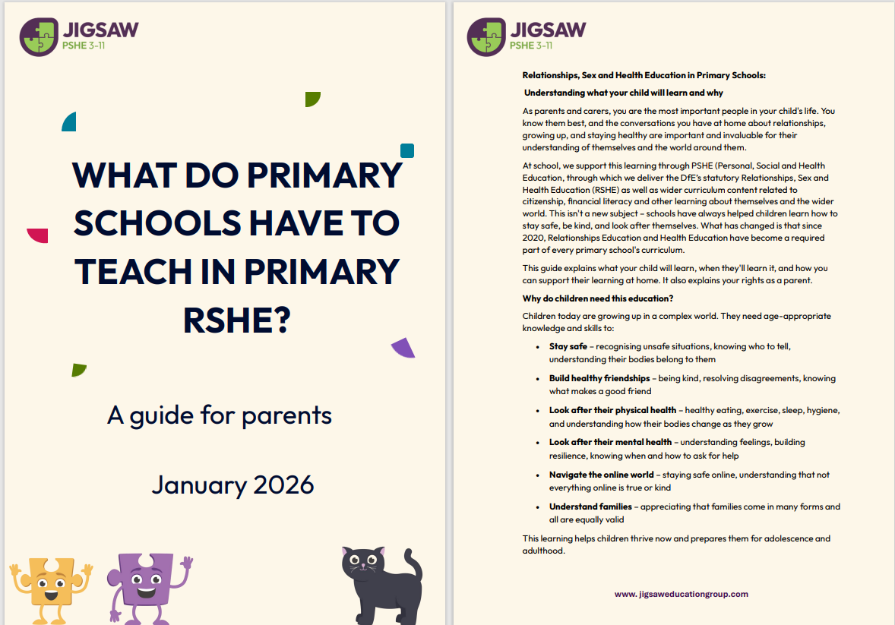
PARENT/CARER PRESENTATION RESOURCES
Available now
Parent/carer presentation
Updated puberty leaflet
Parent/carer access to current puzzle
Updated Snapshot Overview
Coming soon:
Additional leaflet with guidance on talking to your child about sex education
Parent/Teacher Knowledge Organisers
© Jigsaw Education Group
Notes:
We've updated the puberty leaflet for parents, which is available now. And coming soon, we're adding a further leaflet specifically focused on helping parents talk to their children about sex education. This has been a frequently requested resource and we're pleased to be adding it to the suite.

Slide 43

PARENTAL ENGAGEMENT
No significant changes for primary
Parental engagement continues to be a key aspect of developing policy and practice:
Schools must share their RSE policy content online
Parents may request to see the content of any teaching materials for RSE
Jigsaw will:
Update parent presentations, leaflets and continue to provide parent access
Encourage you to engage on ALL areas of PSHE, not just the statutory RSE.
© Jigsaw Education Group
Notes:
The right to withdraw procedures remain the same for primary with emphasis on the fact that before granting any request for withdrawal of a child from sex education, it is good practice for the head teacher to discuss the request with parents, understand the request and to clarify the nature and purpose of the curriculum.
This is likely to include discussing the benefits of sex education, and any detrimental effects of withdrawal, including social and emotional impacts on the child, and the likelihood that the child will hear their peers’ version of what was said in class, which may not be accurate. Schools will want to document this process to ensure a record is kept.
Relationships and Health education remain areas that students and children cannot be withdrawn from.

Slide 44
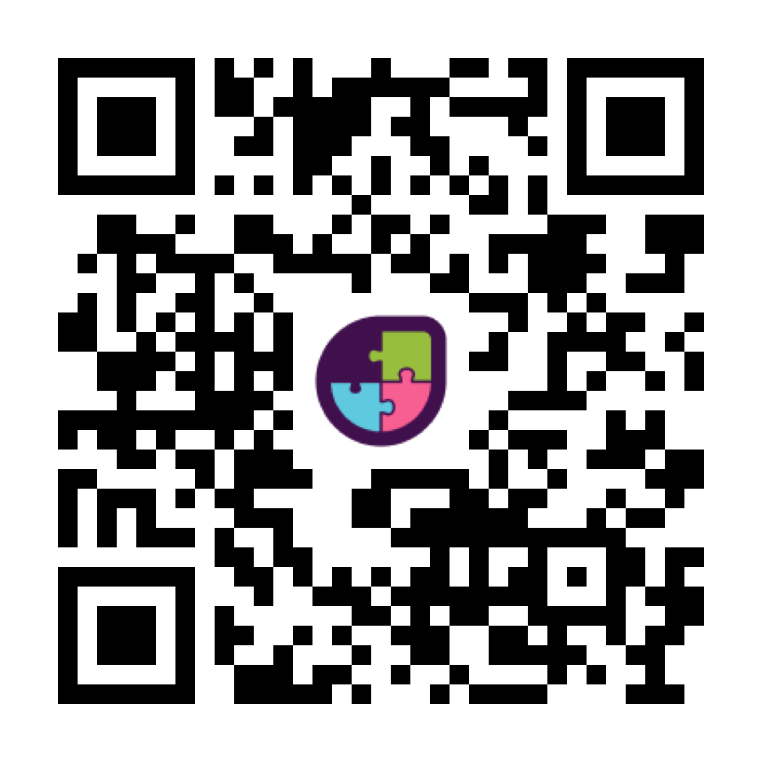
To register interest for any of these free upcoming webinars, use this QR code
March:
A Guide to Policy Writing and Consultation
PSHE in the new OFSTED Framework
Engaging Parents with PSHE
Building Healthy Connections: RSHE Relationships Education
April:
Growing and Changing: Teaching Puberty
Teaching Human Reproduction: Why Teach It in Primary School - and How?
© Jigsaw Education Group
Notes:
We've got more webinars coming up to support you through this transition.
Knowledge Hub – Jigsaw
10/02: Jigsaw PSHE 3-11 Network Meeting
11/06: Jigsaw PSHE 3-11 Network Meeting

Slide 45

3 KEY TAKEAWAYS
You're closer than you think – most of what you're already teaching meets the new requirements
Don't rush – get the groundwork in place before switching to the new materials
Everything you need to get started is ready – the updated content, the guidance documents, the support resources are all there for you
© Jigsaw Education Group

Slide 46




Get in touch – we’re here to help
Schoolsupport@jigsaweducationgroup.com
0333 188 2133
JigsawEducationGroup
www.jigsaweducationgroup.com
Access more training including bespoke online or in-person training for your school through our Knowledge Hub on www.jigsaweducationgroup.com or on the portal.

